Slide 1
A Perspective on Suffering

Slide 2

Evil has stained everything
We cannot unlearn our knowledge of good and evil

Slide 3

Has God abandoned us?
“Lord, what are humans that you care for them,
mere mortals that you think of them?

Slide 4
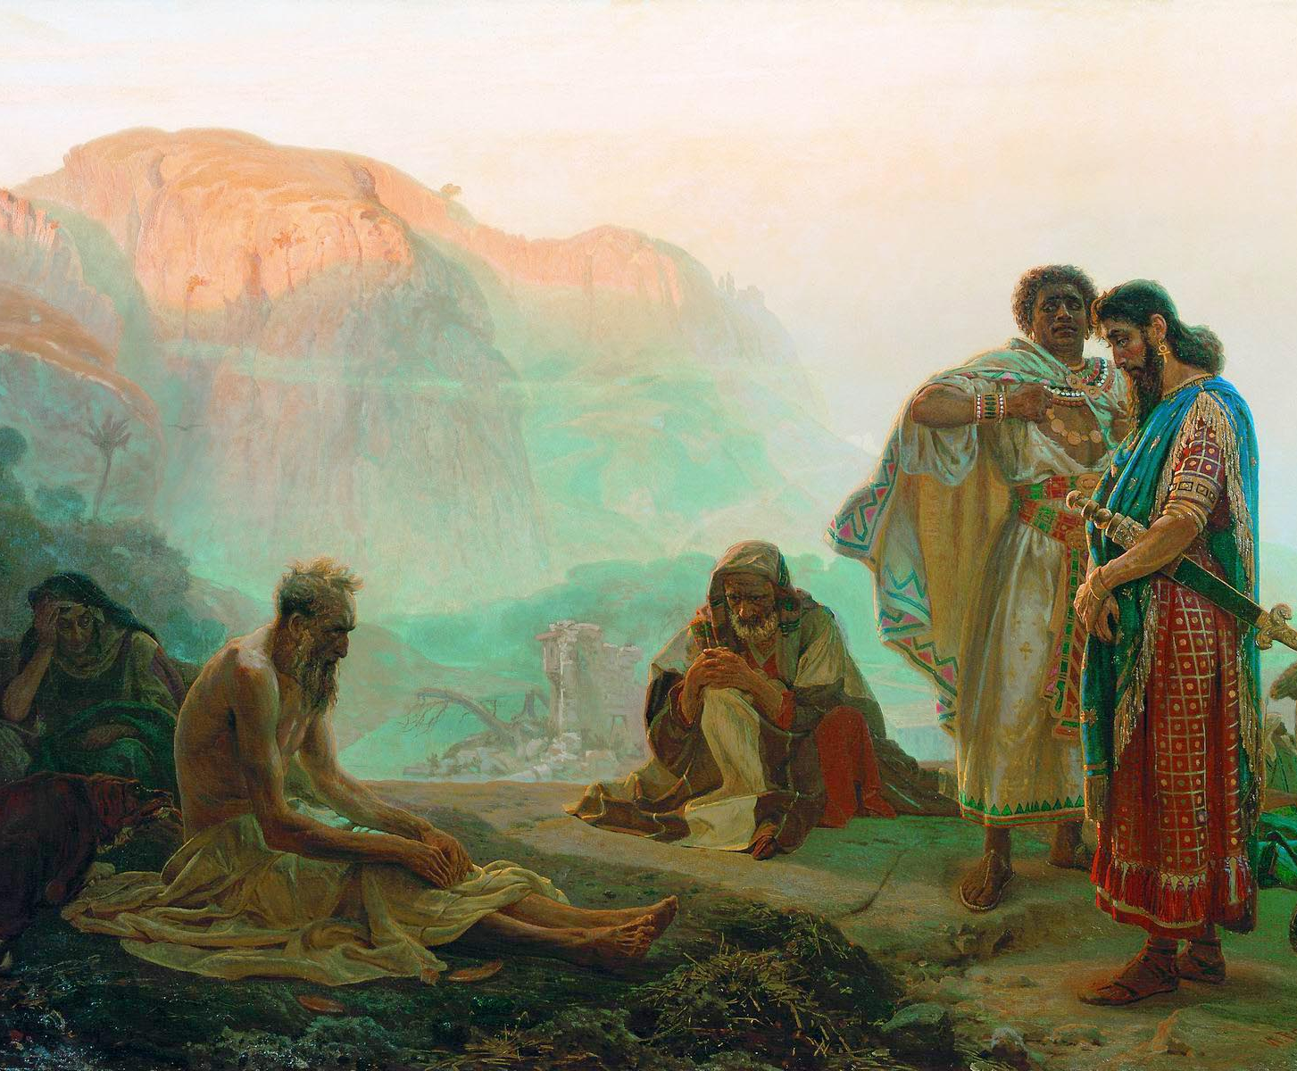
In the face of unjust sufferings
Job committed himself to faith in a redeeming God as he cried out “my Redeemer lives”

Slide 5
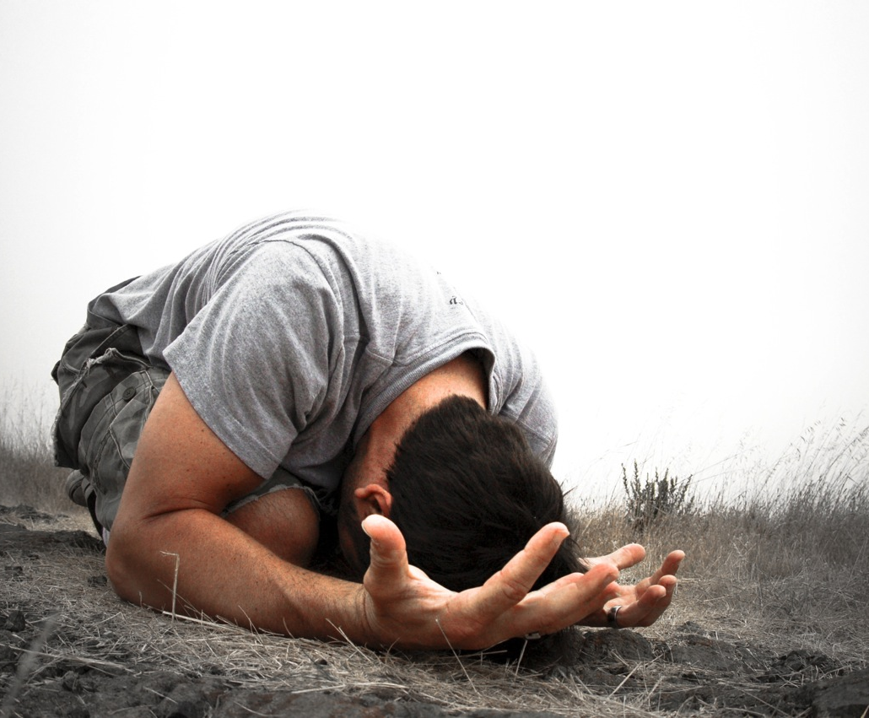
Because Christ suffered and is glorified
your experience of evil can be redeemed too!

