Slide 1
The Wisdom of Joy

Slide 2
The Wisdom of Joy
“Be wise about all that is good and innocent about all that is evil.”
Romans 16.19

Slide 3
“Though you have not seen him, you love him; and even though you do not see him now, you believe in him and are filled with an inexpressible and glorious joy…”
1 Peter 1v8

Slide 4


Slide 5
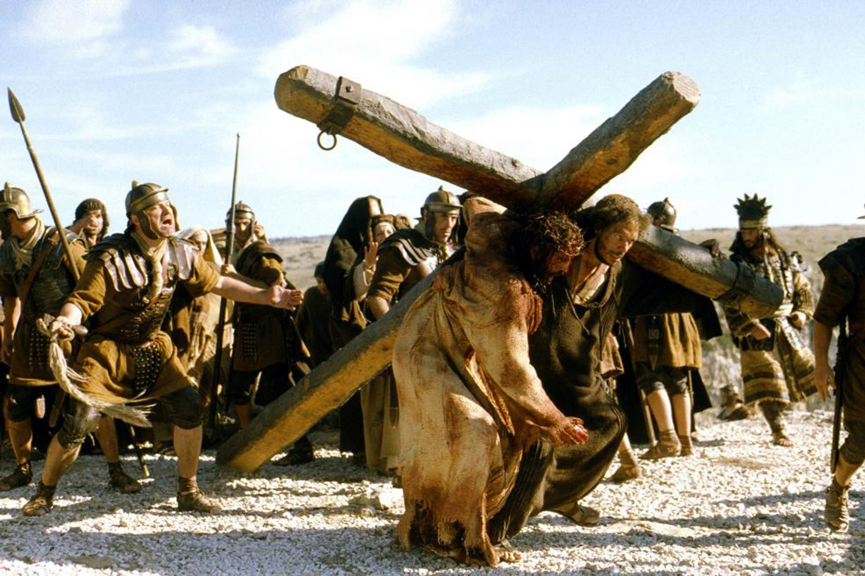

Slide 6





“who for the joy set before him, endured the cross.”

Slide 7
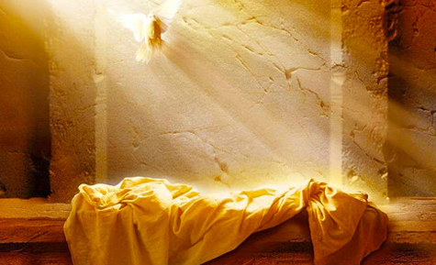

Slide 8
The Permanence of Joy
“Now is your time of grief, but I will see you again and you will rejoice, and no one will take away your joy.” Jn 16.22
“These things I have spoken to you, that My joy may remain in you, and that your joy may be full.” Jn 15.11
“Though the fig tree does not bud and there are no grapes on the vines, though the olive crop fails and the fields produce no food,
though there are no sheep in the pen and no cattle in the stalls,
¹⁸ yet I will rejoice in the Lord,
I will be joyful in God my Savior”. Habakkuk 3.17-18

Slide 9
